Slide 1

2026 Revaluation
Local authority communications toolkit

Slide 2


What is a revaluation?
Every three years the Valuation Office Agency updates the rateable values of over 2 million commercial properties in England and Wales.
This process reflects changes in the market and is known as a revaluation.
Rateable values are the amount of rent a property could have been let for on a set valuation date. For the 2026 revaluation, that date is 1 April 2024. A rateable value isn’t necessarily the same as the amount of rent paid for a property or the level of business rates that it might be liable for.
Rateable values are used by local authorities to calculate business rates bills.
The latest revaluation will come into effect from 1 April 2026 with draft valuations due to be published before the end of 2025.

Slide 3



Key points
Revaluation affects commercial properties including shops, pubs, offices and warehouses, but also includes other properties not used as a home, including beach huts and stables.
Regular revaluations mean that the most up-to-date information is used to calculate business rates bills.

Slide 4


Communicating with ratepayers
Our channels
The VOA blog includes content on how business rates work and how we value properties.
The YouTube channel includes videos on common business rates queries, processes for customers and choosing a business rates agent.
We also share messages for customers through LinkedIn, Facebook and X.
We use direct to customer messaging, social media and other communications to let ratepayers know revaluation is coming and what actions they need to take.
We are also working with partners and stakeholders to help expand our reach.

Slide 5


How you can help
We want to work with local authorities to help reach our customers, making them aware of changes and helping them find the information they need.
We’ve produced a full external communications toolkit with content to help get the message out to ratepayers in your area. This includes:
Communications Toolkit
Download the full communications toolkit here:
Any questions or feedback? Contact the VOA External Communications team on voamediaenquiries@voa.gov.uk.
Social media assets are available from slide 7.
Website content including FAQs
Messaging for business rates bills
Newsletter text
Social media messaging

Slide 6




More resources
Everything you need to know about revaluation 2026: Our recent blog gives businesses all the information and links they need to understand the upcoming revaluation on non-domestic properties.
Help with the 2026 business rates revaluation: Available once future valuations have been published. A GOV.UK page with links and videos intended to direct customers to help with all elements of the revaluation process.
Find a business rates valuation tool: A free tool for people to find the rateable value of any property in England and Wales. From here, businesses can also get an estimate of what their future business rates bill might be from 1 April 2026. This is only intended to give an indication of what your business rates bill might be and may not take into account any relief you might be eligible for.
Business Rates Valuation Account: The key online service for ratepayers who think their valuation is wrong or want to correct their property details (such as floor area sizes and parking). This tool is also used to appoint an agent or get more information about your valuation.

Slide 7
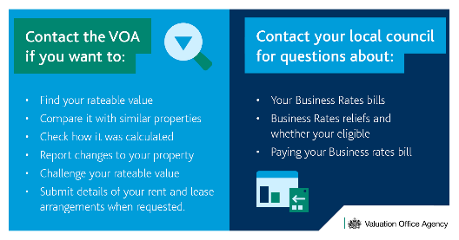
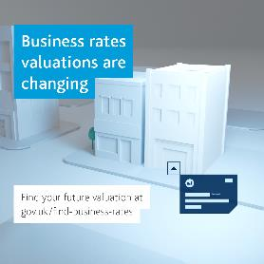

Social media assets
To download the image, right-click on the image and select Save As to save it to your computer.
Or download here:

